Slide 1
2 : The Internet
Prof. Yousef B. Mahdy
Faculty of Computers and Information
Assiut University

Slide 2
Web Basics
The Web consists of computers on the Internet connected to each other in a specific way
The Web has a client/server architecture
Web browsers
  Also called browsers
  Programs used to connect client-side computers to the Internet

Slide 3
The Internet
On October 24, 1995, the FNC unanimously passed a resolution defining the term Internet. This definition was developed in consultation with the leadership of the Internet and Intellectual Property Rights (IPR) Communities.
RESOLUTION: "The Federal Networking Council (FNC) agrees that the following language reflects our definition of the term "Internet". "Internet" refers to the global information system that –
  is logically linked together by a globally unique address space based on the Internet Protocol (IP) or its subsequent extensions/follow-ons;
  is able to support communications using the Transmission Control Protocol/Internet Protocol (TCP/IP) suite or its subsequent extensions/follow-ups and/or other IP-compatible protocols; and
  provides, uses or makes accessible, either publicly or privately, high level services layered on the communications and related infrastructure described herein."
A shared infrastructure, owned by no one: Much like the railway network, no one company owns it.

Slide 4
The Internet
The ‘net’ is composed of:
  Various types of wires and cable
  Computer hardware/ software
  Digital switches, and
  Peripheral technologies that support data flow and network security
Network connecting other networks

Slide 5
Internet Technologies
The World Wide Web
A way to access and share information
  Technical papers, marketing materials, recipes, ...
A huge network of computers: the Internet
Graphical, not just textual
Information is linked to other information
Application development platform
  Shop from home
  Provide self-help applications for customers and partners
  ...
Notes:
The Web can be viewed from many different perspectives.

Slide 6
The Internet
Networks owned by different governments and organizations
Consists of different levels of backbone national level, regional level
The backbones are owned and operated by different Internet service providers and governments
The backbone meet at network access points (NAPs) and metropolitan area exchanges (MAEs).

Slide 7
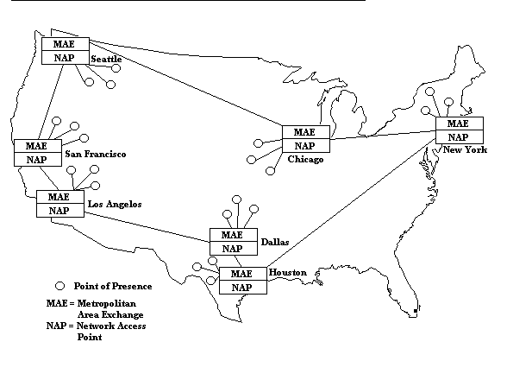
The Internet

Slide 8
The Internet
Backbones: carry data among regionals and owned by AT&T, Sprint, MCI, Qwest...
Regionals: connecting LANs to backbones
LANs
  Local, organizational, universities
  ISPs with local access through a national ISP
End users
  Dialup (50 Kbps)
  ISDN (64-128 Kbps)
  ASDL (1.5 Mbps/512 kbs
  LAN (1-10 Mbps)
  Cable modem (5-10 Mbps)
  Satellite dish...

Slide 9
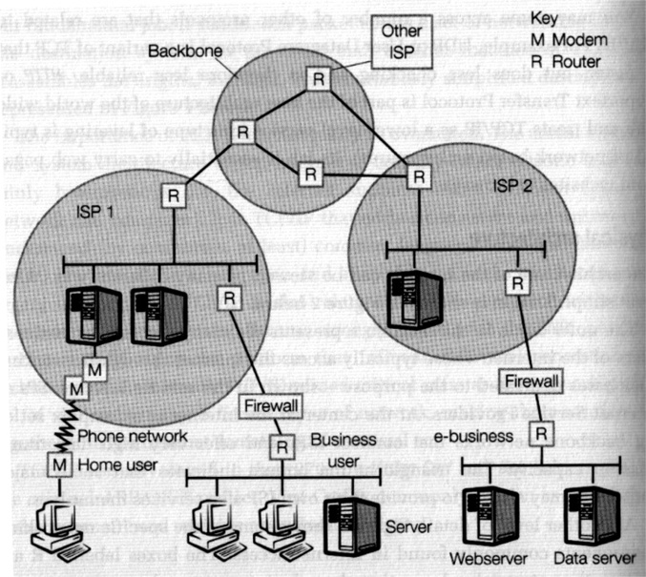
A Simplified View of the Internet

Slide 10
A Simplified View of the Internet
Home user
Connected to an ISP (labeled M) via a modem and the phone network.
The modem will allow a phone line to carry a digital signal.
The ISP has multiple modems to deal with many incoming phone calls).
Business user
A local area network of multiple machines.
A router (labeled R) takes a set of IP packets and sends them to the next stage of their journey across multiple points of interconnection between different networks.
A firewall (software & hardware) protects the business network from intrusion.

Slide 11
A Simplified View of the Internet
Internet Service Provider (ISP)
Provides access to both business and home users.
The ISP runs its own network, and may offer services such as website hosting (running customers’ websites) or its own contents (on-line service provider).
Backbone Networks
To route IP traffic to other points in the Internet, the ISP offers a “point of presens (POP)” that allows the ISP to connect to the backbone networks at the core of the Internet.
NSFNet in the early days of the Internet; Major operators today include MCI Worldcom, Sprint, Uunet, GTE, etc.

Slide 12
A Simplified View of the Internet
“Network Access Points (NAP)”
Allow backbone and and ISP traffic to be connected (see next slide)
E-business
See diagram labelled (ISP2) supporting e-business that runs its own website and associated data servers.
Users may access this e-business through the multiple links shown in the diagram.

Slide 13
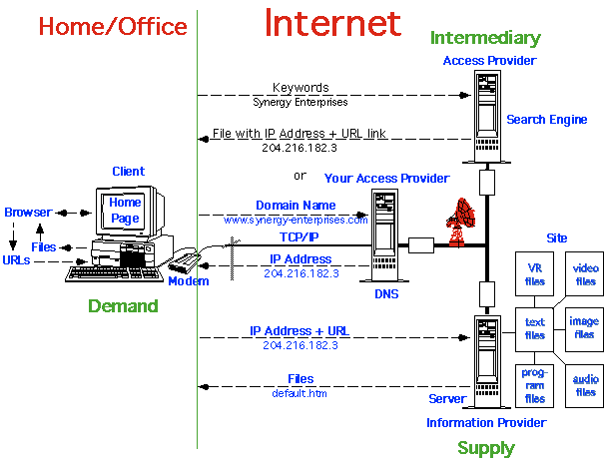
Internet Definitions Diagram

Slide 14
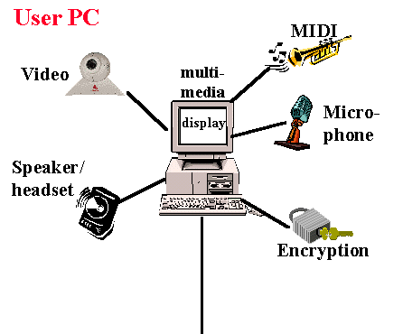
Internet: "The Big Picture "
User PC - A Multi-Media PC equipped to send and receive all variety of audio and video.

Slide 15
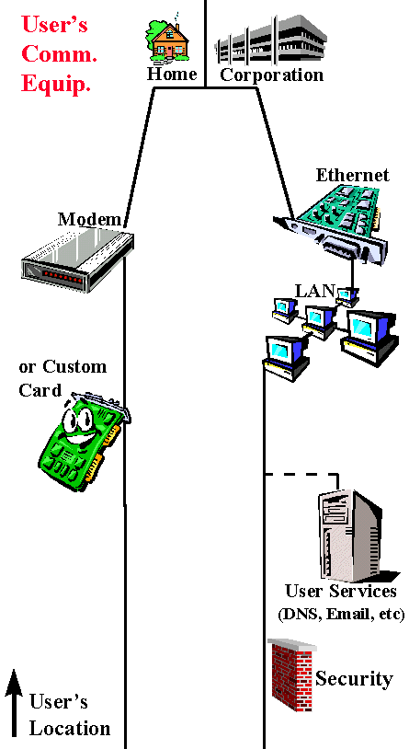
Internet: "The Big Picture "
User's Communication Equipment - This is the communication equipment located at the User's location(s) to connect the Users' PC(s) to the "Local Loop" (aka Customer Premise equipment - CPE)

Slide 16
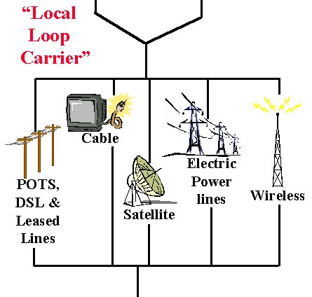
Internet: "The Big Picture "
Local Loop Carrier - Connects the User location to the ISP's Point of Presence

Slide 17
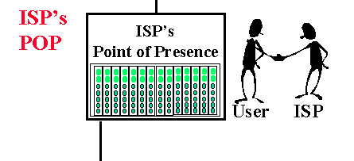
Internet: "The Big Picture "
ISP POP- This is the edge of the ISP's network. Connections from the user are accepted and authenticated here.

Slide 18
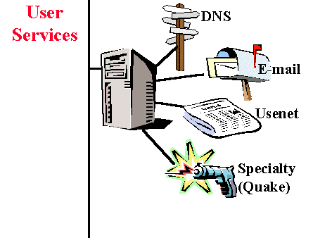
Internet: "The Big Picture "
User Services - these are the services that most users would use along with Internet Access.

Slide 19
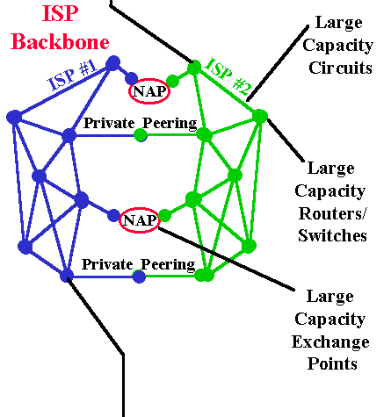
Internet: "The Big Picture "
ISP Backbone - The ISP backbone interconnects the ISP's POPs, AND interconnects the ISP to Other ISP's and online content.

Slide 20
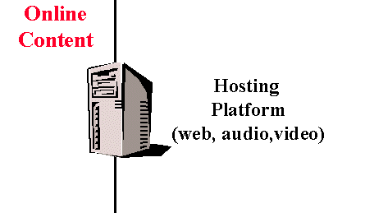
Internet: "The Big Picture "
Online Content - These are the host sites that the user interacts with.
Web Server platforms - Netsite, Apache, Microsoft, Yahoo's List of web servers.
Hosting Farms- Many online resources are hosted at well-connection facilities
These servers require fast interfaces and large/fast storage.

Slide 21
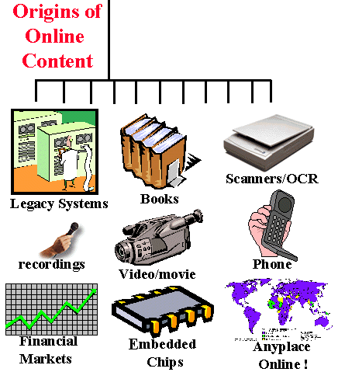
Internet: "The Big Picture "
Origins of online content - This is the original "real-world" sources for the online information.

Slide 22



Internet Technologies
WWW Architecture
Client
PC/Mac/Unix
+ Browser
Request:
http://www.msn.com/default.asp
Network
TCP/IP
Response:
<html>…</html>
Server
Web Server
Notes:
This is the basic architecture of the web. A browser running on a client machine makes a request to a server using the HTTP protocol over TCP/IP. The server responds with an HTML page, which is rendered in the browser.

Slide 23
World Wide Web
In 1990, Tim Berners-Lee of CERN (the European Laboratory for Particle Physics) developed the World-Wide Web (www) and several communication protocols that form the backbone of the web.
The www allows computer users to locate and view multimedia-based documents (i.e., documents with text, graphics, animations, audios and/or videos) on almost any subject.

Slide 24
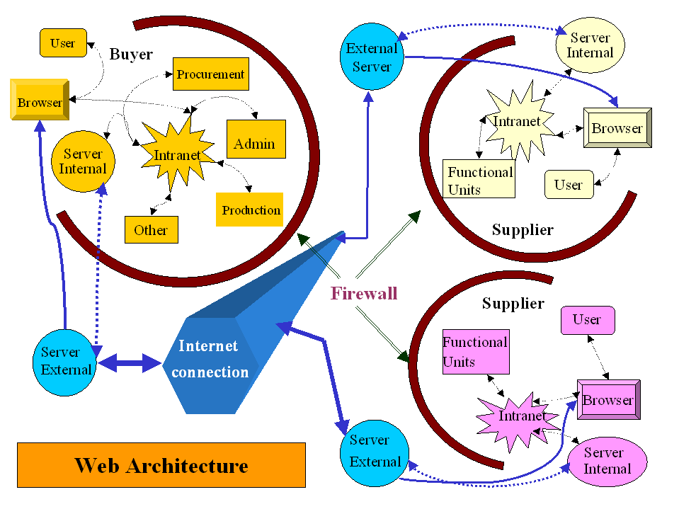

Slide 25
The World-Wide Web
Not the Internet
  WWW is one of many services on the internet.
  WWW can be considered to be a user-friendly interface to information on the internet.
Enabled by a standard: HTML... and VRML, Java, PDF, ...
Uses URL (Uniform Resource Locators): a unified address scheme that allows information to be exchanged using a variety of exchange techniques:
  Hypertext: http://www.whitehouse.gov/
  The white house
  FTP: ftp://ftp.iicm.edu/pub/Vrweb
  to access virtual library at Graz University of Technology in Austria
  Telnet: telnet://fedix.fie.com:23/
  to access the Federal Information Exchange

Slide 26
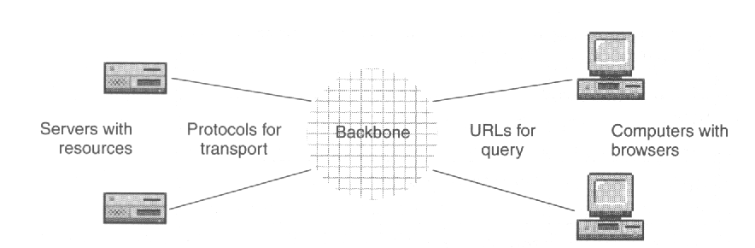
Uniform Resource Locator
URL identifies a specific resource on a server in a domain
URL tells what protocol to use to access the resource
URL format:
how://where/what
http://www.csupomona.edu/~hco

Slide 27
Other URL Protocols
https: secure, encrypted HTTP
ftp: file transfer protocol
mailto: email
telnet: remote login
news: obtain Usenet news
irc: Internet Relay Chat
finger: obtain information about a user
gopher: indexes of text files
archie: ftp databases

Slide 28
Browser
Implements HTTP (Hypertext Transfer Protocol)
  Displays web pages
  Access authentication
  Caching, freshness control
Font mapping, e.g. Unicode
http://www.unicode.org/iuc/iuc10/x-utf8.html
Compression, decompression
Handles multimedia, manages plug-ins
Interprets scripts
Executes Java applets
Maintains cache, history
Manipulates cookies

Slide 29
Web Basics
Web servers
  Run special Web server software
  Listener
    Component included in Web server software
    Monitors for messages sent to it from client browsers

Slide 30
Web Basics
Web page
  Usually a file with an .htm or .html extension that contains Hypertext Markup Language (HTML) tags and text
  HTML
    Document layout language (not a programming language)
    Defines structure and appearance of Web pages
    Allows Web pages to embed hypertext links to other Web pages

Slide 31
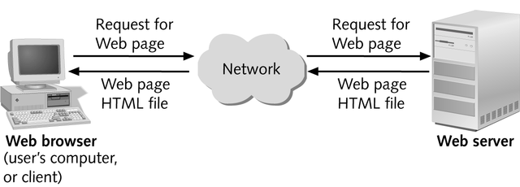
Web Basics
Web client/server architecture

Slide 32
Internet Technologies
WWW Architecture
Client/Server, Request/Response architecture
  You request a Web page
    e.g. http://www.msn.com/default.asp
    HTTP request
  The Web server responds with data in the form of a Web page
    HTTP response
    Web page is expressed as HTML
  Pages are identified as a Uniform Resource Locator (URL)
    Protocol: http
    Web server: www.msn.com
    Web page: default.asp
    Can also provide parameters: ?name=Leon

Slide 33
Communication Protocols and Web Addresses
Communication protocols
  Agreements between sender and receiver regarding how data are sent and interpreted
  Internet is built on two network protocols:
    Transmission Control Protocol (TCP)
    Internet Protocol (IP)
  Interaction b/w Browser and Server is governed by the HTTP protocol (Request/Response Tx)
    HTTP is stateless!
      (Will discuss in more detail when processing forms)

Slide 34
Communication Protocols and Web Addresses
Packets
  Data that can be routed independently through Internet
Domain name
  Represents an IP address
A domain names server maintains tables with domain names matched to their IP addresses
Internet Service Providers (ISPs)
  Provide commercial Internet access

Slide 35
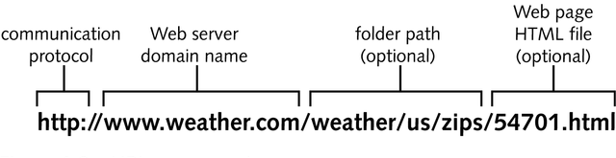
Communication Protocols and Web Addresses
Hypertext Transfer Protocol
  Communication protocol used on the Web
Web address
  Also called Uniform Resource Locator (URL)
URL Components

Slide 36
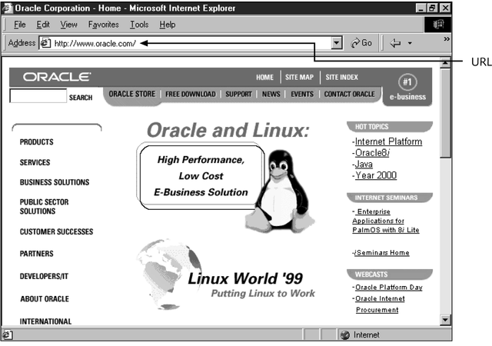
Communication Protocols and Web Addresses
If folder path is not specified, Web server assumes default starting point is Web server’s root document folder
URL that displays default home page

Slide 37
Communication Protocols and Web Addresses
Internet URLs
  Specify a Web server or domain name
  Specify communication protocol as first part of URL
File URL
  HTML file stored on user’s hard drive

Slide 38
Running Multiple Listener Processes on the Same Web Server
Running multiple listeners is managed through the concept of ports
Ports
  Identified by a number that specifies which TCP/IP-based listener or server running on a computer, at a given IP address, is going to receive a message coming in from the network
  You will set up a port for the Apache server on SNG

Slide 39
Internet Technologies
Web Design Principles
Interoperability: Web languages and protocols must be compatible with one another independent of hardware and software.
Evolution: The Web must be able to accommodate future technologies. Encourages simplicity, modularity and extensibility.
Decentralization: Facilitates scalability and robustness.

Slide 40
Internet Technologies
Hypertext Markup Language (HTML)
The markup language used to represent
Web pages for viewing by people
  Designed to display data, not store/transfer data
Rendered and viewed in a Web browser
Can contain links to images, documents,
and other pages
Not extensible
Derived from Standard Generalized Markup Language (SGML)
HTML 3.2, 4.01, XHTML 1.0
Notes:
Objects such as images, audio, video, and documents are not actually enclosed in the HTML Web page, but are referenced by the page. When you tell your browser to display a Web page, it may have to make multiple requests to the server (or possibly different servers) to get all the referenced objects.
Example:
Get default.asp may result in additional requests for the following files:
Get image1.gif
Get image2.jpeg
Get video1.mpeg
…

Slide 41
Internet Technologies
HTML Forms
Enables you to create interactive
user interface elements
  Buttons
  Text boxes
  Drop down lists
  Check boxes
User fills out the form and submits it
Form data is sent to the Web server via HTTP when the form is submitted

Slide 42
Internet Technologies
Hypertext Transport Protocol (HTTP)
The top-level protocol used to request and return data
  E.g. HTML pages, GIFs, JPEGs, Microsoft Word documents, Adobe PDF documents, etc.
Request/Response protocol
Methods: GET, POST, HEAD, …
HTTP 1.0: simple
HTTP 1.1: more complex

Slide 43
Internet Technologies
HTTP
HTTP is a stateless protocol
Each HTTP request is independent of previous and subsequent requests
HTTP 1.1 introduced keep-alive for efficiency
Statelessness has a big impact on how scalable applications are designed

Slide 44
Internet Technologies
Cookies
A mechanism to store a small amount of information (up to 4KB) on the client
A cookie is associated with a specific web site
Cookie is sent in HTTP header
Cookie is sent with each HTTP request
Can last for only one session (until browser is closed) or can persist across sessions
Can expire some time in the future

Slide 45
Design Principles
Interoperability: systems can be assembled using client and server computers and software from different vendors.
Layering: Internet protocols are designed to work in layers, with each higher layer building on the facilities provided by the lower layers.

Slide 46
Simplicity
  Beside performing a specific function, each layer in a layered network hides network implementation details (the complexity of many different kinds of network hardware, topologies, and router) from the layers above it.
  IP provides only addressing and formatting of packets. Application developers and users are insulated from the complexities of different network hardware, topologies, and routers (e.g., Ethernet, dial-up connections, etc.), as well as the complexities of implementing low level network protocols.

Slide 47
IP Addresses
Uniform Naming and Addressing
  IP addresses track topology (physical location)
  Domain names track administrative responsibility.
  DNS is a distributed database of names.
  Network servers maintain tables of domain names.
  IP addresses are obtained by resolves that communicate with name servers on the net.

Slide 48
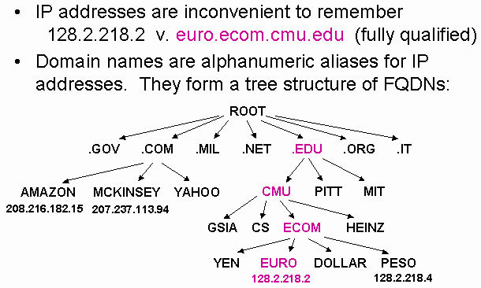
IP Addresses

Slide 49
IP Addresses
Each host on the Internet has a unique IP address
  Assigned by the Internet Corporation for Assigned Names and Numbers (ICANN http://www.icann.org/)
  32-bit address: dotted decimal notation, e.g., 204.202.129.230
  Each IP number represents one of 256 locations (domain.subdomain.organization.host)
  Each number represents an increasingly lower level of network (from Class A --> B --> C --> Node)

Slide 50
IP Addresses
IP addresses are stored in domain name servers (DNS)
  Once a host knows the IP address of the intended receiver, the packets can be sent
  Each packet has an IP # for the sender, one for the receiver, and a sequence number for reassembling
We use alphabetic address:
(userID@host.institution.domain)
Main domains: edu, com, gov, mil, org, net + country codes
Local DNS converts this address into the IP address automatically
  Like phone book, matches the name to the phone number
  If it cannot resolve the address, it sends a request to the next DNS in the hierarchy
  This continues until the address is resolved or an error message is returned

Slide 51
Internet Host
What is an “Internet Host?”
  A computer on the Internet that has a permanent IP address (fixed IP address).
  A service provider has one IP address for every 8~10 customers.
  Each IP address is associated with a phone line. When you dial up and make a connection, your computer is associated with the IP address allocated to the phone line you are connected.
  There are about 100,000,000 IP address on the Internet.

Slide 52
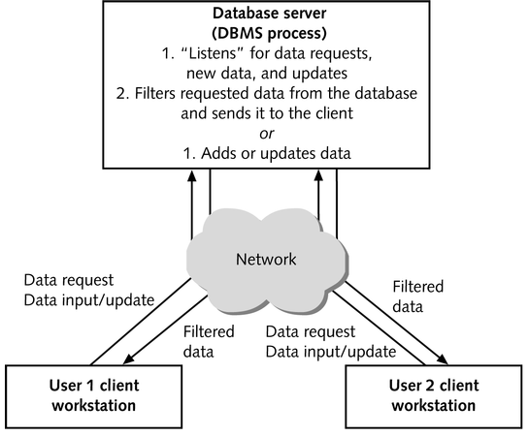
Personal and Client/Server Databases
Using a client/server database for a multiuser application

Slide 53
Personal and Client/Server Databases
A client/server database is less affected when a client workstation fails
  The failed client’s in-progress queries are lost, but the failure of a single client workstation does not affect other users
In case of server failure in a client/server database, a central synchronized transaction log contains a record of all current database changes

Slide 54
Personal and Client/Server Databases
Personal databases are useful:
  For Web installations where the only database operation is viewing data and no action queries are used
  Where less robust recovery and security systems can be tolerated
  Eg MS Access.

Slide 55
Personal and Client/Server Databases
Longstanding and useful guideline
  When a personal database is used for multiuser applications, usage should be limited to no more than 10 concurrent users if action queries are allowed
If security or the ability to recover from client or server failures is important, use a client/server DBMS regardless of the number of concurrent users
You will use Oracle and MS-Access.

Slide 56
Dynamic Web Pages
Static Web page
  Page content established at the time page is created
  Useful for displaying data that doesn’t change often, and for navigating between HTML Web page files
Dynamic Web page
  Also called an interactive Web page
  Page content varies according to user requests or inputs

Slide 57
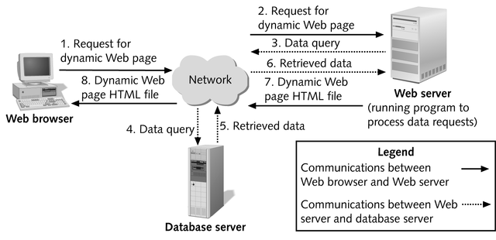
Dynamic Web Pages
Database-driven Web site Architecture

Slide 58
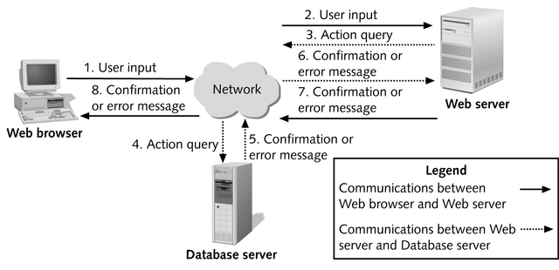
Dynamic Web Pages
Database-driven Web site architecture for action query

Slide 59
Approaches for Creating Dynamic Web Pages
In server-side processing, the Web server:
  Receives the dynamic Web page request
  Performs all of the processing necessary to create the dynamic Web page
  Sends the finished Web page to the client for display in the client’s browser

Slide 60
Approaches for Creating Dynamic Web Pages
Client-side processing
  Some processing is done on the client workstation, either to form the request for the dynamic Web page or to create or display the dynamic Web page
  Eg Javascript code to validate user input.
  Often needs to be “executed” by the Browser.

Slide 61
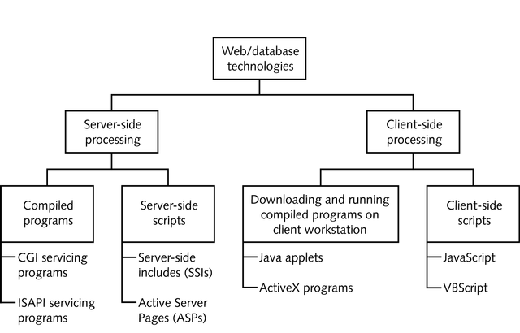
Approaches for Creating Dynamic Web Pages
Curl
ASP.NET
JSP, PHP
Server-side and client-side Web database technologies

Slide 62
Client-side Processing
One approach to client-side processing involves downloading compiled executable programs stored on the Web server to the user’s Web browser and then running them on the user’s workstation
  This program interfaces with the user and, as needed, sends and retrieves data from a database server
  A Java applet uses this approach

Slide 63
Client-side Processing
Java
  Programming language that is a simplified subset of C++
  Commonly used to create Web applications, called Java applets, that can be downloaded from a Web server to a user’s browser and then run directly within the user’s browser
  Java applets run identically on any operating system and with any Web browser
  CURL – replacement for java applets and javascript; new. See http://www.curl.com

Slide 64
Client-side Processing
Microsoft’s ActiveX also sends a compiled executable program to the user’s workstation
ActiveX program are generally used to create intranet applications
  An intranet is a self-contained internal corporate network based on Internet protocols but separate from the Internet
  Active X programs are capable of modifying data on the client machine (eg registry) – security risk

Slide 65
Client-side Processing
Another client-side processing approach involves client-side scripts (cannot modify user machines eg delete files)
  Allows uncompiled code in languages such as JavaScript or VBScript or .net* (MS only) to be typed into the HTML document along with the static HTML text
  More complex user interfaces are possible with this approach than with straight HTML
  Allows user inputs to be checked for correctness on user’s workstation rather than on Web server

Slide 66
Server-side Processing
The most common server-side dynamic Web page technology uses HTML forms
  Enhanced documents designed to collect user inputs and send them to the Web server
  HTML forms allow users to input data using text boxes, option buttons, and lists
  When the form is submitted, the servicing program on the Web server process the form inputs and dynamically composes a Web page reply

Slide 67
Server-side Processing
Common Gateway Interface (CGI) protocol
  Used as a method for communicating between the HTML form and the servicing program
  Disadvantage of using CGI-based servicing programs is that each form submitted to a Web server starts its own copy of the servicing program, potentially causing memory problems for the Web server
  Starts another program/script to perform processing.
    Often written in PHP, PERL, Shell scripts, C.

Slide 68
Server-side Processing
Web server vendors have developed proprietary technologies to process form inputs without starting a new copy of the servicing program for every form
  Netscape’s Netscape Service Application Programming Interface (NSAPI)
  Microsoft’s Internet Server Application Programming Interface (ISAPI)

Slide 69
Server-side Processing
Another approach for creating dynamic Web pages using server-side processing uses server-side scripts
  Server-side script is uncompiled code included within an HTML Web page file to extend its capabilities
  Examples of technologies using this approach include Server-side includes (SSIs) and Microsoft Active Server Pages (ASPs)
    From 2002, Microsoft’s ASP.NET

Slide 70
Server-side Processing
JSP – Java server pages – combine markup (HTML or XML) with Java code to dynamically create web pages.
ColdFusion – proprietary product which uses <CF…/CF> tags to invoke functions on the server
ASP.NET ‘similar’ to ASP but can use any language to write code; is OO; separates code from HTML form.
  We will use VB.NET (full programming language not just a script).

Slide 71
Configuring Internet Access for a Network

Slide 72
Overview
Options for Connecting a Network to the Internet
Configuring Internet Access by Using a Router
Configuring Internet Access by Using NAT

Slide 73
Options for Connecting a Network to the Internet
Connecting to the Internet by Using a Router
Securing Internet Connections by Using a Firewall
Connecting to the Internet by Using NAT
Connecting to the Internet by Using Internet Connection Sharing
Connecting to the Internet by Using a Proxy Server
Comparing Internet Connectivity Options

Slide 74







Connecting to the Internet by Using a Router
Connecting Your Network to the Internet by Using a Router:
  Optimizes network performance
  Enables all users in your network to share a single connection to the Internet
  Is the easiest method for connecting your network to the Internet
Intranet
Internet
Router

Slide 75







Securing Internet Connections by Using a Firewall
Securing Internet Connections by Using a Firewall:
  Prevents unauthorized access to your network
  Enables you to specify the type of traffic that is allowed into and out of your network
Firewall
Intranet
Internet
Router

Slide 76







Connecting to the Internet by Using NAT
Client Computers
Internet
Computer Running NAT
Internal IP = 192.168.1.1
External IP = 131.107.2.1
IP = 192.168.1.3
Web Server
IP = 131.107.50.1
IP = 192.168.1.4
The client sends the packet to the computer running NAT
The computer running NAT changes the packet header and sends the packet over the Internet to the Web server
The Web server sends a reply to the computer running NAT
IP = 192.168.1.5
The computer running NAT determines the destination, changes the packet header, and sends the packet to the client

Slide 77
Connecting to the Internet by Using Internet Connection Sharing
Connecting to the Internet by Using Internet Connection Sharing:
  Simplifies the process of configuring NAT
  Enables small-office and home-office networks to share a single connection to the Internet
Small-Office or Home-Office Network
Internet
Internet Connection Sharing

Slide 78







Connecting to the Internet by Using a Proxy Server
Connecting to the Internet by Using a Proxy Server:
  Provides security by acting as a gateway between your network and the Internet
  Caches information to reduce traffic between your intranet and the Internet
LAN
Internet
Proxy Server

Slide 79
Configuring a Web Server

Slide 80
Overview
Overview of IIS
Preparing for an IIS Installation
Installing IIS
Configuring a Web Site
Administering IIS
Troubleshooting IIS

Slide 81


Overview of IIS
~~~ ~~~ ~~~
~~~ ~~~ ~~~
~~~ ~~~ ~~~
SERVER
Intranet
Internet
A Windows 2000 /2003 Server Running IIS Provides:
World Wide Web (WWW) Server
File Transfer Protocol (FTP) Service
Network News Transfer Protocol (NNTP) Service
Simple Mail Transfer Protocol (SMTP) Service

Slide 82





Preparing for an IIS Installation
Install TCP/IP
Configure a Static IP Address
192.168.120.133
Establish a Domain Name
nwtraders.msft
Configure NTFS
NTFS

Slide 83
Installing IIS
To Install IIS
Perform the Installation:
Add Internet Services Manager to the
Administrative Tools Menu
Create the Default Web Site and the
Default FTP Site
Test the Installation:
Use Internet Explorer to View Files in
the Home Directory, C:\inetpub\wwwroot

Slide 84
Configuring a Web Site
Configuring Web Site Identification
Configuring the Home Directory
Identifying Methods of Authentication
Selecting a Method of Authentication
Configuring Authentication
Assigning a Default Document

Slide 85
Selecting a Method of Authentication
Authentication
Method
Use When
Anonymous
You want users to access public areas of your
web site
Basic
You want to authenticate users who access your web site through any browser or proxy server
Digest
You want to secure authentication for your web sites and you must go through a proxy server
Integrated Windows
You are configuring an intranet site, where both the users and the web server are in the same domain, or in domains with a trust relationship

Slide 86
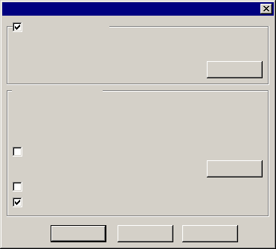
Configuring Authentication
Authentication Methods
Anonymous
Access
Anonymous access
No user name/password required to access this resource.
Account used for anonymous access:
Edit…
Authenticated access
For the following authentication methods, user name and
password are required when:
- anonymous access is disabled, or
- access is restricted using NTFS access control lists
Basic
Authentication
Basic authentication (password is sent in clear text)
Select a default domain
Edit…
Digest
Authentication
Digest authentication for Windows domain servers
Integrated Windows
Authentication
Integrated Windows authentication
OK
Cancel
Help

Slide 87
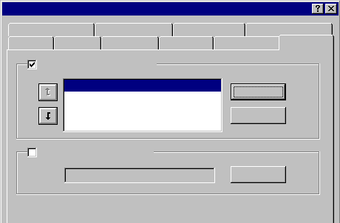
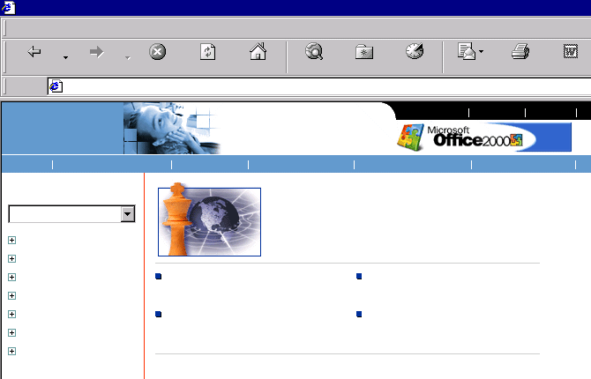
Assigning a Default Document
Default Web Site Properties
Directory Security
HTTP Headers
Custom Errors
Server Extensions
Web Site
Operators
Performance
ISAPI Filters
Home Directory
Documents
Enable Default Document
Default.htm
Add...
Default.asp
iisstart.asp
Welcome to Microsoft’s Homepage - Microsoft Internet Explorer
File Edit View Favorites Tools Help
Remove
Back
Forward
Stop
Refresh
Home
Search
Favorites
History
Mail
Print
Edit
Enable Document Folder
http://www.microsoft.com/ms.htm
microsoft.com
Home
Browse...
Home
Events & Training
Subscribe
About Microsoft
U.S. & International
About Our Site
See page customized for:
Are You Ready to Take on the Chess Master?
All
Product Families
Business Customers
Developers
Education
Home User
IP Professionals
Partners & Resellers
Find Out What’s Happening at
PC Expo in New York
Enter to Win a Gateway PC Loaded
with Office 2000
Rick Rashid: The Steady Hand
Behind Microsoft Research
Download Outlook Updates for the
E-mail Attachments Virus

Slide 88
Administering IIS
Use Internet Services Manager to Manage Web Servers Remotely
Use System Monitor to Monitor IIS Performance

Slide 89
Troubleshooting IIS
Testing a Web Site Connected to the Internet
Testing a Web Site on Your Intranet
Resolving IIS Problems

Slide 90
Lab A: Configuring a Web Server

